Slide 1

CMR COLLEGE OF ENGINEERING & TECHNOLOGY
Kandlakoya, Medchal, Hyderabad - 501401
Department of Computer Science and Engineering
TRAINING AND PLACEMENT MANAGEMENT SYSTEM
Team 05:
20H55A0501 C.SRIKANTH
20H55A0505 D.SATHISH
20H55A0512 J.POOJA
Under esteemed guidance of:
B.GAYATHRI (Assistant Professor)

Slide 2
Outline
Abstract
Introduction
Technologies used
Literature survey
Existed system
- Problems in existed system
Objective
Problem Definition
Research work
- Proposed system
-Proposed system architecture
Result
Conclusion
References
Notes:
2

Slide 3
Abstract
Notes:
3

Slide 4
ABSTRACT
Training and placement management system is a web-based application in the windows platform for the training and placement assistance for all students at campus drives. Through this application we providing the trainings and placements drives which ever upcoming and present. Here we place all kind of information regards about trainings and placement drives and locations where it was held and the upcoming drives, we provide previously asked questions were uploaded here and we provide the statistics about placements who ever got placed using this application. We providing chatbot system in the application to give the answers to the questions which ever queries raised by the students and get resolved on time there itself. This application was easily accessible by any non-technical person as well. It was developed with good interface and functionable.

Slide 5
INTRODUCTION
Notes:
5

Slide 6

Introduction
The use of the Internet to enable students and companies to manage the placement process with the active involvement of the Placement Coordinator. This led to a unique web-based training and placement management system.
Online training and placement management system provides information on placement providers and the placements they offer so that students may view and assess their opportunities.
In this application administrator provide access points to the company coordinators and TPO’s of the college to update the drives and trainings which are taking part of upcoming and running drives.
Notes:
6

Slide 7
Literature Survey
Notes:
7

Slide 8

Existed system
Problems in existing system:
Maximum manual work: in the existing system all the work that is done by human intervention.Humans should do all the work.
Application interface: lack of GUI interface of the application.
Updating records: due to above problems the updating was very difficult.
Less alertness: the students may not get the information on training and placement activity hence they miss the opportunities.
Alumni record: the past students records are not maintained.
There are no record of placed statistics maintained and not updated.
No onspot query solving method implemented.
Notes:
8

Slide 9
Objective
Notes:
9

Slide 10

Objective
Our main objective is to develop a web based application to manage the Trainings and Placements at colleges level which are called as campus placements
And organizing the recruiters and TPO’s at a place in online
platform which makes easy to students to know about
the drives and trainings which are planed as on or
off campus placements and trainings.
It improves existing system.
Reducing the manual work.

Slide 11
Problem Definition
Notes:
11

Slide 12
Problem Definition
The existing system is doing all the processes manually.The administrator should refer all the records kept for years ago to simply know details.This so tedious and time consuming.
This process is so difficult when the number of users increases.
The students are not being made aware of the Training and Placement activity hence there might have been loss of opportunities.
Developing a web application which will be help full for students to recive all kinds of information regarding placements and trainings viz. this application has ability to allow students to ask queries and get them resolving there it self.

Slide 13
Research Work
Notes:
13

Slide 14
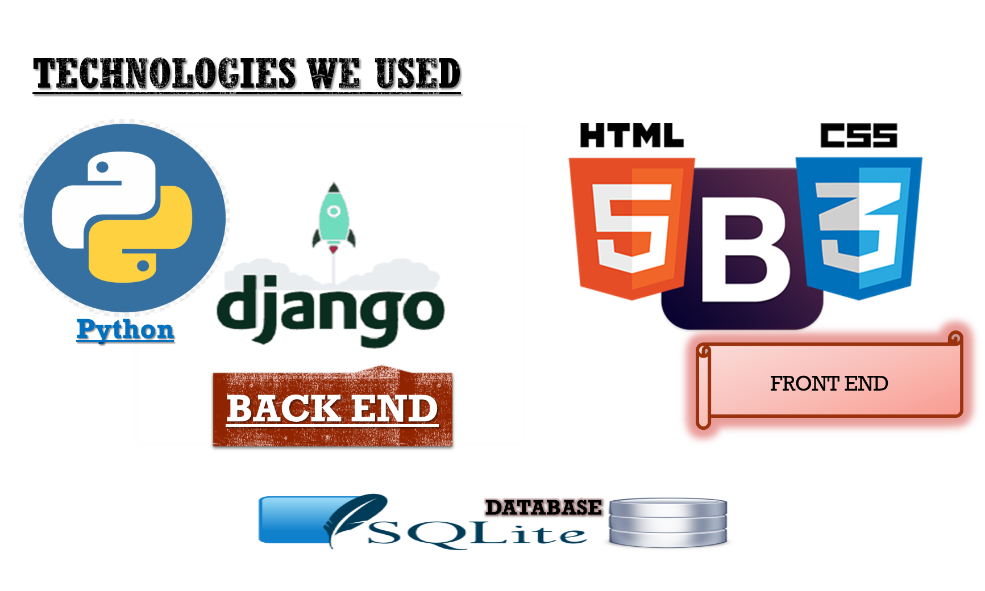
Notes:
14

Slide 15
Proposed System
The proposed system gives the automation to maintaining data, authorized access and easy communication of information to students.
Overcomes the limitations of the existing system and ensures to provide:
Queries answered through chatbot system
Automatization of Entering and Accessing data
Addresses single point of contact
Eases the task of recruiters
Reduces paperwork and saves time
Easy communication of information to students
Risk of loss of opportunities substantially reduced

Slide 16
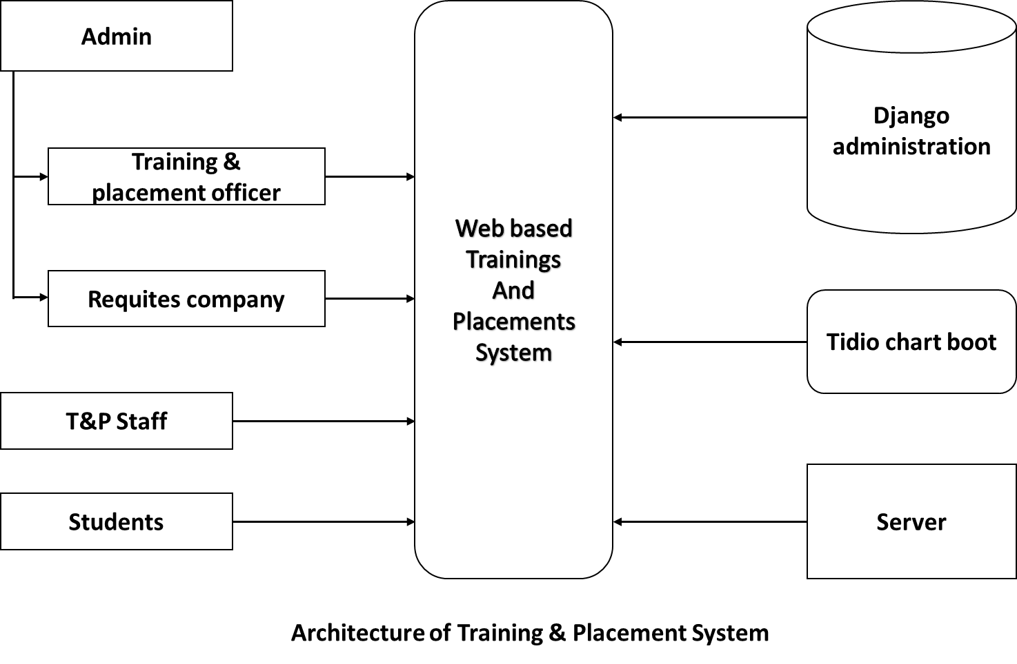
Proposed system architecture

Slide 17
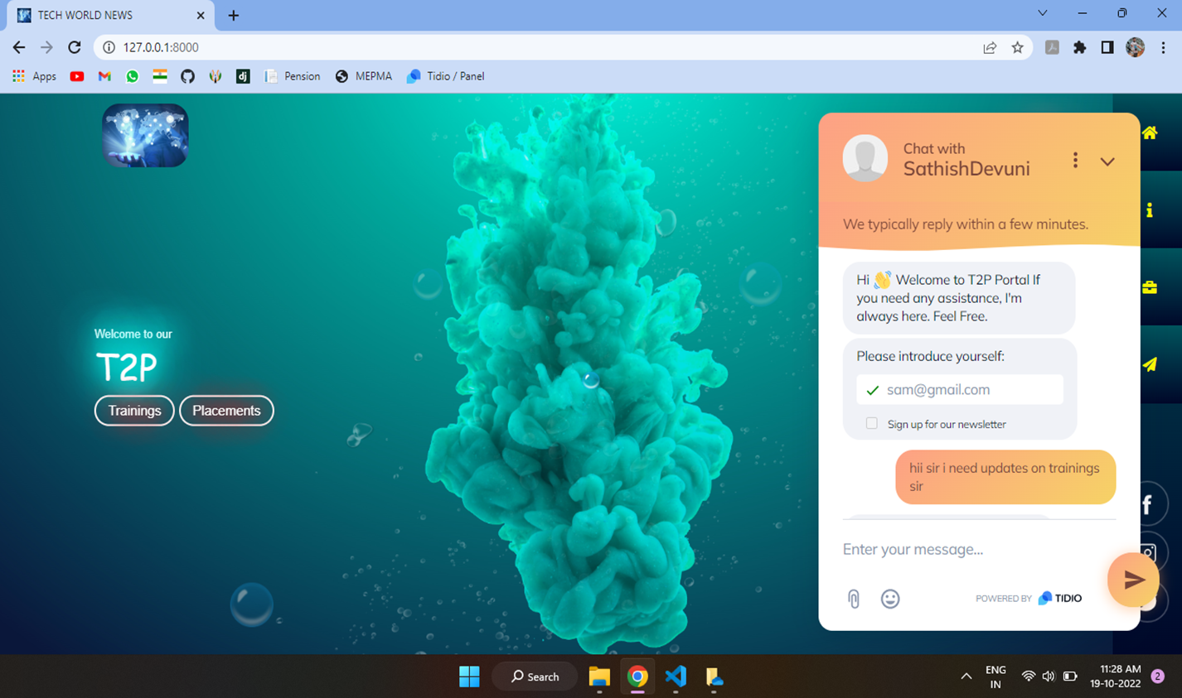
Result
Home Page of Training & Placement System

Slide 18
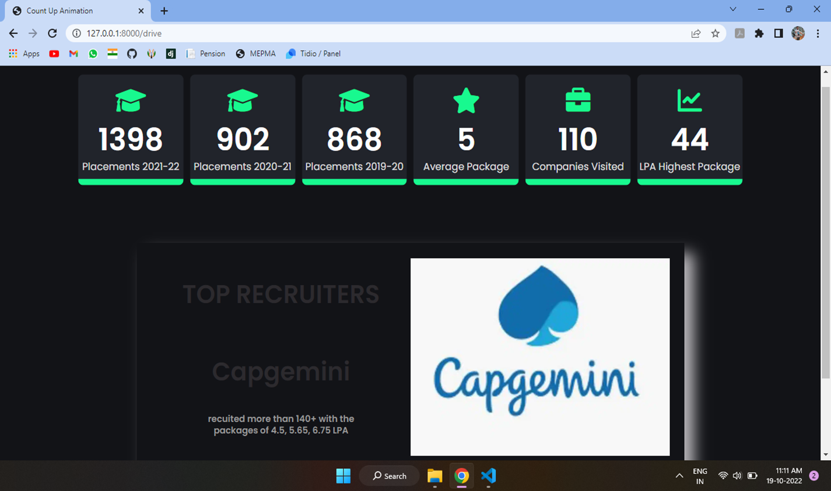
PLACEMENT STATISTICS

Slide 19
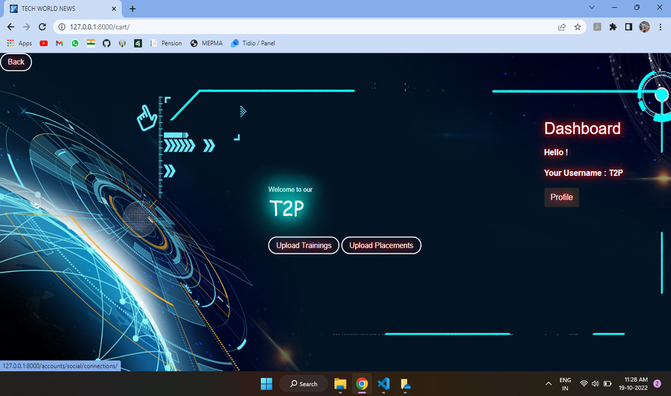
RECRUITERS DASHBOARD

Slide 20
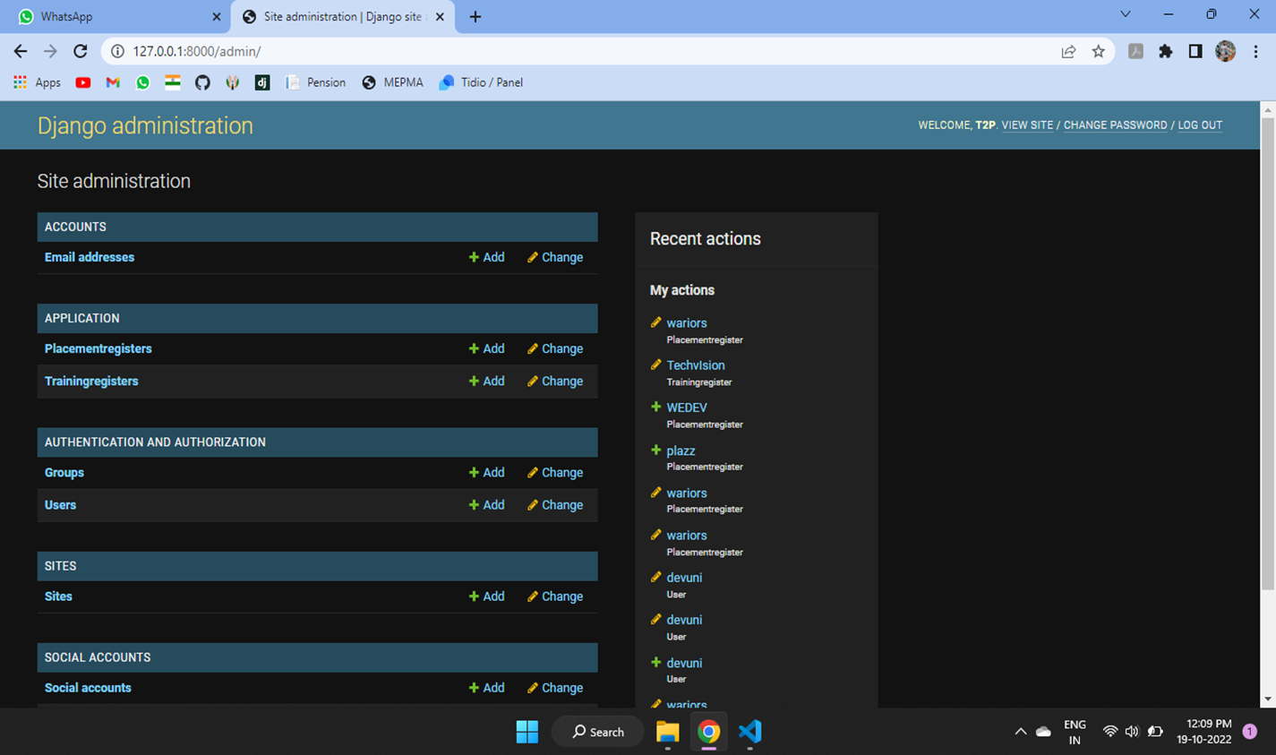
Administration Work

Slide 21
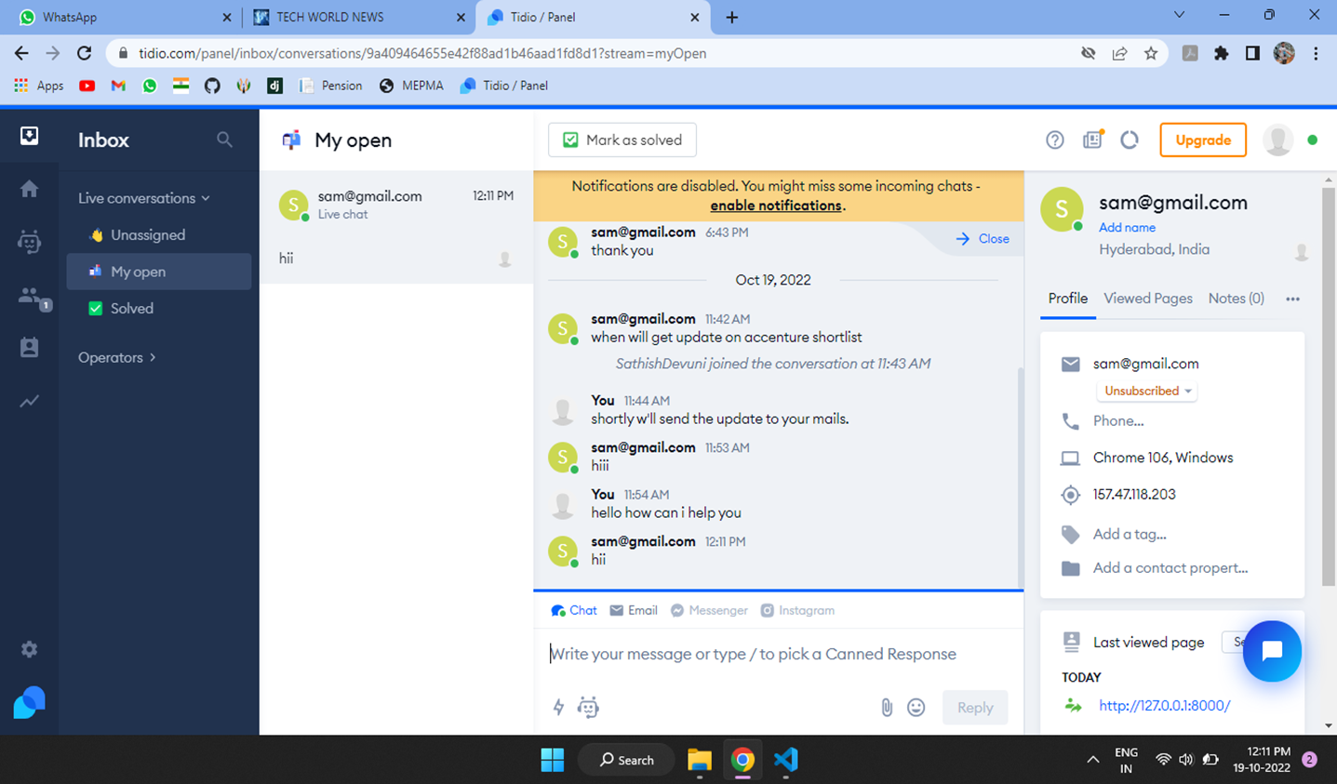
Tidio chartboot system

Slide 22

Conclusion
The proposed online training and placement management system gives the automation in all the process like registration, updation. It provides the detail solution to the existing system problem. And getting resolve of problem were done there it self with on time. There is no lack of interaction with the administrator for the quires.

Slide 23
References
https://docs.djangoproject.com/en/4.1/
https://www.tidio.com/panel/dashboard
www.w3schools.com
www.wikipedia.com
www.tutorialspoint.com

Slide 24
Thank You!

